Slide 1
OLAP Concepts
Part 1
<OLAP Concepts 101 Series>
Anupama Putcha

Slide 2
Module Overview
On-Line Analytical Processing is a decision support software that allows the user to quickly analyze information that has been summarized into multidimensional views and hierarchies.
There are three main features of OLAP system :
Multidimensional Viewing – OLAP supports multidimensional model which consists of facts and dimensions also called as Star Schema.
Calculation Intensive Capabilities – Due to data is stored in facts and dimensions tables, it enables users to analyze data without much calculations.
Time Series analysis – Enables users to analyze data across time.
This Module will cover the details in three parts:
Part 1 – Importance of BI, DWH Architecture and different reporting types.
Part 2 – Data Access and Analysis, OLAP Introduction and Types

Slide 3
OLAP Objectives – Part Overview
Upon completion of this Part module you will be able to:
Appreciate the importance of Business Intelligence
Know the basic Data warehouse Architecture
Understand Different types of reporting
Notes:
‹#›
Online Analytical Processing is an approach to quickly answer multi-dimensional analytical queries.
The typical applications of OLAP are in for sales, marketingThe typical applications of OLAP are in for sales, marketing, business process managementThe typical applications of OLAP are in for sales, marketing, business process management (BPM), budgetingThe typical applications of OLAP are in for sales, marketing, business process management (BPM), budgeting and forecastingThe typical applications of OLAP are in for sales, marketing, business process management (BPM), budgeting and forecasting, financial reporting and similar areas.
The term OLAP was created as a slight modification of the traditional database term OLTP (Online Transaction Processing).
OLAP Concepts are categorized as:
.Understanding the need for data-warehouse, typical architecture and different ways of business reporting
.Understanding the data access and analysis
.Understanding the OLAP types
These details are covered in two parts. This presentation is part 1 of the series.

Slide 4
OLAP Outline
Lesson 1 Importance of Business Intelligence
Lesson 2 Data warehouse Architecture
Lesson 3 Reporting Types

Slide 5
Importance of Business Intelligence

Slide 6


Traditional DSS - Limitations
Spreadsheets and SQL are traditionally used as tool for analysis and decision making
Limitations of Traditional techniques
It is very difficult to define the aggregation levels, views in spreadsheets
SQL does not have a natural way of providing flexible view reorganizations that will transpose the data
Common analytic functions such as cumulative average and total are not supported in SQL
Extensive programming
Redundant reporting

Slide 7
Business Intelligence - Significance
Often Business Intelligent applications use data gathered from a data warehouse or a data mart.
A DWH houses a standardized, consistent, clean and integrated form of data sourced from various operational systems in use in the organization, structured in a way to specifically address the reporting and analytic requirements.
Data warehouses can become enormous with hundreds of gigabytes of transactions. As a result, subsets, known as "data marts," are often created for just one department or product line.

Slide 8
Business Intelligence - Future
In a 1958 article, IBM researcher Hans Peter Luhn used the term business intelligence. He defined intelligence as: The ability to apprehend the inter-relationships of presented facts in such a way as to guide action towards a desired goal.
Business Intelligence uses concepts and methods to improve business decision making by using fact-based support systems
BI technologies provide historical, current, and predictive views of business operations. Common functions of Business Intelligence technologies are reporting, OLAP, analytics, data mining, business performance management and predictive analytics.
Business Intelligence often aims to support better business decision-making. Thus a BI system can also be referred as a decision support system.

Slide 9
BIDW Architecture
Notes:
Hello friends
I am Anupama, and today I shall take you through one of the key elements of a data-warehouse, called OLAP concepts. We have put together few slides that will explain all about it.
At the end of this session, you would get a fair idea of OLAP concepts and understand the different types of OLAP reporting.
The Target Audience is:
Team Rainbow (TRB) associates assigned to DW-BI practice after completion of Induction training
Associates newly joined to DW-BI practice with out prior DWH implementation experience
We shall begin our session with an overview of OLAP concepts.

Slide 10
Data warehouse Architecture
Architecture, in the context of an organization's data warehousing efforts, is a conceptualization of how the data warehouse is built.
Data warehouses are generally batch updated at the end of the day, week or some period. Its contents are typically historical and static and may also contain numerous summaries.
Notes:
‹#›
© 2009 Wipro Ltd – Internal & Restricted
‹#›

Slide 11
A typical data warehouse
A typical data warehouse consists of …
Source data
Staging area
Warehouse
Data Marts
Reports
Analytical environment

Slide 12

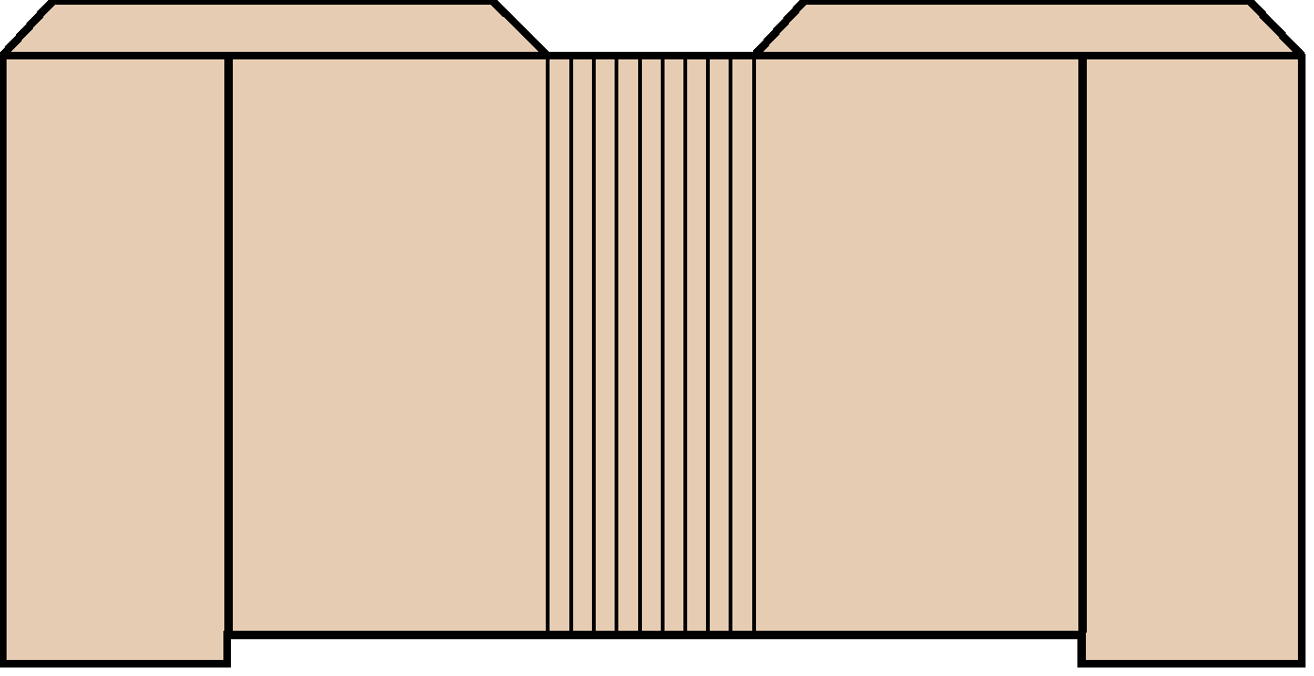



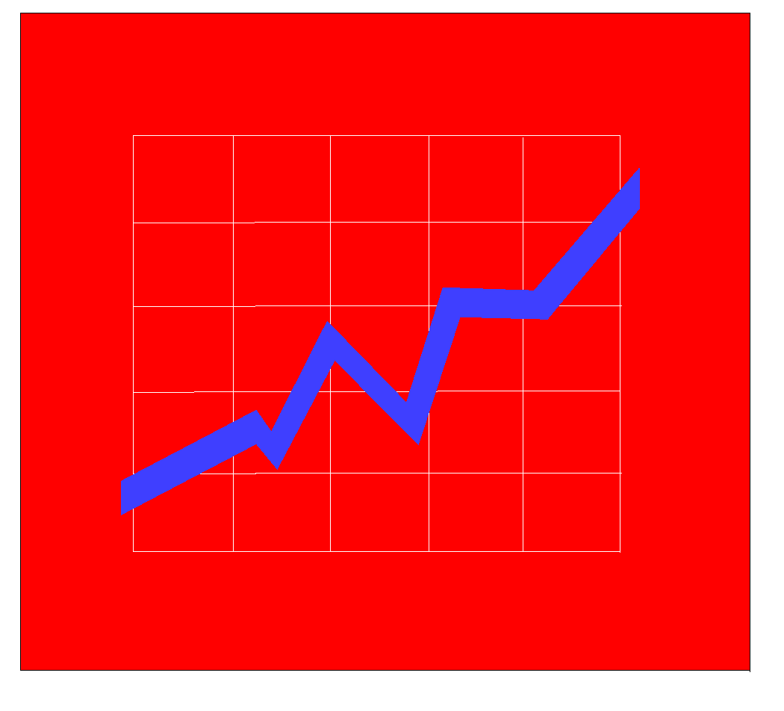
Warehouse Architecture - A
EIS /DSS
Metadata
Select
Extract
Transform
Integrate
Maintain
Query Tools
Data
Warehouse
OLAP/ROLAP
Operational
Systems/Data
Web Browsers
Middleware/
API
Data
Preparation
Data Mining
Enterprise Data Warehouse

Slide 13
Warehouse Architecture - B
Metadata
EIS /DSS
Data Mart
Select
Extract
Transform
Integrate
Maintain
Metadata
Query Tools
Data Mart
OLAP/ROLAP
Metadata
Operational
Systems/Data
Web Browsers
Data Mart
Middleware/
API
Data
Preparation
Data Mining
Single Department Data Mart

Slide 14
Warehouse Architecture - C
Data
Marts
EIS /DSS
Metadata
Select
Extract
Transform
Integrate
Maintain
Query Tools
Data
Warehouse
OLAP/ROLAP
Web Browsers
Operational
Systems/Data
Operational Data Store
Middleware/
API
Data
Preparation
Data Mining
Multi-tiered Data Warehouse

Slide 15
Reporting Types

Slide 16
Type of Reporting
Transaction Systems Reporting
Replicated OLTP Reporting
Data Mart Reporting
Enterprise Data Warehouse Reporting
Notes:
‹#›
© 2009 Wipro Ltd – Internal & Restricted
‹#›

Slide 17
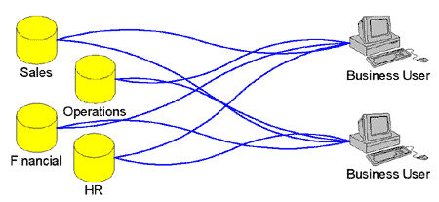
Transaction Systems Reporting
Reports are created from the transaction systems
Reporting Tool has a native connectivity to
The OLTP database or
A generic data access protocol such as ODBC, JDBC or OLE DB is made use of
This type of reporting is needed for time-sensitive reporting
E.g. those reports which need to be up to date with the transactions occurring within the last 24 hours

Slide 18
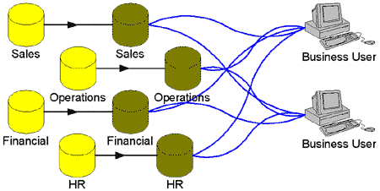
Replicated OLTP Reporting
Replication to the offline data store is done by
Transaction logs
Database replication
Batch files

Slide 19
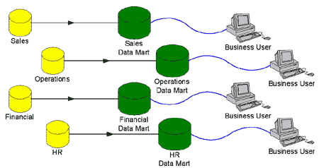
Data Mart Reporting
Another method is to feed transaction data to a system optimized for reporting (data mart)

Slide 20
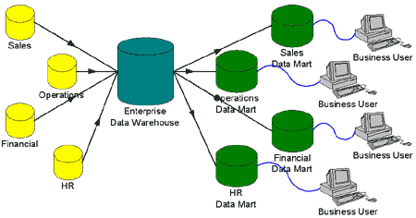
Enterprise Data Warehouse Reporting
An enterprise data warehouse (EDW) is designed
To combine data from multiple OLTP systems
To provide consolidated and cleansed data to an array of data marts
Notes:
‹#›
Before we begin with understanding OLAP concepts, it is important to understand the meaning of BI and a data warehouse.
Data warehouse is a repository of an organization's electronically stored data. Data warehouses are designed to facilitate reporting and analysis.
A data warehouse houses a standardized, consistent, clean and integrated form of data sourced from various operational systems in use in the organization, structured in a way to specifically address the reporting and analytic requirements.
The concept of data warehousing dates back to the late 1980s. In essence, the data warehousing concept was intended to provide an architectural model for the flow of data from operational systems to decision support environments.
Upon completion of this module you will be able to:
Appreciate the importance of Business Intelligence
Know the basic Data warehouse Architecture
Understand Different types of reporting.

Slide 21
Query and Reporting tools
Query and reporting tools are used for providing Reporting Solutions
One type of classification
Ad hoc Query Tool
Managed Query Tool
Notes:
‹#›
This module has 3 Lessons.
The first one is Importance of Business Intelligence.
Business Intelligence often aims to support better business decision-making. The term business intelligence is often used as a synonym for competitive intelligence.
The second one is Data warehouse Architecture.
The means to retrieve and analyze data, to extract, transform and load data, and to manage the data dictionary are considered some of the essential components of a data warehousing system.
The third one is Reporting Types.
Business intelligence tools are a type of application software are a type of application software designed to report, analyze and present data. The tools generally read data that have been previously stored, often, though not necessarily, in a data warehouse are a type of application software designed to report, analyze and present data. The tools generally read data that have been previously stored, often, though not necessarily, in a data warehouse or data mart.
The key general categories of business intelligence tools are:
SpreadsheetsSpreadsheets, Reporting and querying softwareSpreadsheets, Reporting and querying software - are tools that extract, sort, summarize, and present selected data ,OLAPSpreadsheets, Reporting and querying software - are tools that extract, sort, summarize, and present selected data ,OLAP Tools ,Digital Dashboards etc.
The different OLAP tools are : Cognos, Business Objects, Hyperion etc.

Slide 22
Query and Reporting tools
Ad hoc Query Tool
Lets the user create a SQL query in a graphical environment
Supports limited complex analysis
Connects to external data sources through ODBC
Examples :
Microsoft Access
MS Query
Managed Query Tool
Has a semantic layer to hide database complexity from the user
Presents the user with a semantic layer in the business terms
Has security management, usage limits, report sharing
Examples :
Oracle Discoverer
Business Objects
Cognos Impromptu

Slide 23
Quiz

Slide 24
Question 1
Data warehouse is a <Fill in the blanks> collection of data, specifically structured for information access and reporting. Mark the incorrect answer:
Subject Oriented
Time Variant
Non-Volatile
Segregated
Answer: D

Slide 25
Question 2
2. Traditional Decision Making tools include:
BI Reporting
Excel
Analytical reporting
SQL
Answer: B and D

Slide 26
Question 3
3. In a typical data warehouse architecture the Data Marts are expected to be created after:
Source data
Staging
Data warehouse
reports and analytics
Answer: C

Slide 27
Question 4
4. Historical data is not available with which of the following options.
Data Mart Reporting
Transaction Systems Reporting
Replicated OLTP Reporting
Enterprise Data Warehouse Reporting
Answer: B and C

Slide 28
Question 5
5. Managed Query tools can be used on.
Transaction/OLTP Reporting
Data Mart Reporting
Replicated OLTP Reporting
Enterprise Data Warehouse Reporting
Answer: B and C

Slide 29
References

Slide 30
References
Publications
Courses
The OLAP Solutions – Building Multidimensional Information Systems Second Edition by Erik Thomsen, Wiley dream tech India Pvt. Ltd. 2002 ISBN 81-265-0275-4
URL’s
Training Programs
Tek-tips reporting solutions forum
http://www.dmreview.com/
http://www.dwinfocenter.org

Slide 31
Thank You
Anupama Putcha
Senior Software Engineer
anupama.putcha@wipro.com

